Slide 1
JSliders
By Nathan DeLano

Slide 2
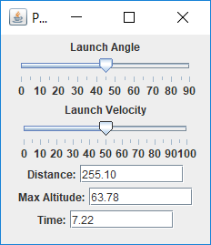
What is a JSlider

Slide 3
How to create a JSlider
1). Create the object
Private JSlider demoSlider = new JSlider( JSlider.HORIZONTAL, min, max, initial );
2.) Connect it to a listener
demoSlider.addChangeListener( new SliderListener());
3.) Add slider to panel
add(demoSlider);

Slide 4
ChangeListener
Part of Swing Class
Need to be imported
import javax.swing.event.ChangeEvent;
import javax.swing.event.ChangeListener;
Need to be added to slider
demoSlider.addChangeListener(new SliderListener());
Similar to action listener
public void stateChanged ( ChangeEvent event )
{
JSlider source = (JSlider)event.getSource();
if (!source.getValueIsAdjusting());
{ … }
}

Slide 5
Bonus
Ticks can also be added to sliders
demoSlider.setMajorTickSpacing(10);
demoSlider.setMinorTickSpacing(5);
velocitySlider.setPaintTicks(true);
velocitySlider.setPaintLabels(true);

Slide 6
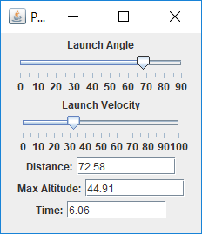
Activity
Calculate projectile motion using VelocityPanel.java and VelocityGUI.java

